Slide 1
X-ray Vision: Utilizing Deep Learning for COVID-19 Detection and Severity Prediction from Chest X-ray Images
Done By:
Anandan Biswas(RA2111003010431)
Shanjith Vijay(RA2111003010439)
Sanjay jk (RA2111003010441)

Slide 2
ABSTRACT
Our project aims to create a solution that can easily detect covid-19 in an automated way, especially when The need for auxiliary diagnostic tools has increased as there are no accurate automated toolkits available. So, we're going to use Transfer Learning with advanced and popular architectures like VGG16, VGG19, ResNet50 and trying out SIAMESE with pre-trained weights on the popular ImageNet dataset. This implementation use Keras with a TensorFlow backend, and it will be performed Then adapted to our dataset which is full of X-ray images in Covid-19 and No_findings folders.

Slide 3
INTRODUCTION
The COVID-19 pandemic, stemming from the SARS-CoV-2 virus, has inflicted profound impacts on global healthcare systems, particularly evident in the recent surge of cases overwhelming healthcare facilities in regions like India. With millions succumbing to the virus and many more enduring lingering health complications, the urgency for effective diagnostic and management strategies has never been more pressing. Recognized symptoms of COVID-19, ranging from fever and dry cough to loss of taste/smell and respiratory distress, underscore the diverse clinical manifestations of the disease . While real-time reverse transcription polymerase chain reaction (RT-PCR) remains the gold standard for confirmation, chest X-rays (CXRs) and computed tomography (CT) scans are pivotal in corroborating diagnoses and assessing pulmonary involvement .
Despite their widespread use, accurate interpretation of chest X-ray images demands specialized expertise, exacerbating challenges posed by the global shortage of radiologists . In light of these constraints, the integration of artificial intelligence (AI) holds promise in augmenting diagnostic capabilities and streamlining workflow efficiencies. By harnessing AI-driven algorithms, healthcare providers can mitigate diagnostic errors, alleviate workload burdens, and enhance diagnostic accuracy through reference-based decision support systems.

Slide 4
The multifaceted battle against COVID-19 extends beyond traditional medical interventions, with technology serving as a critical ally in mitigating transmission risks and optimizing resource utilization. Robotics and AI applications have revolutionized various aspects of pandemic management, from contactless sampling and vital sign monitoring to surveillance and enforcement of quarantine protocols [6]. Within this context, our study proposes an AI-driven diagnostic framework tailored for the automated identification of COVID-19-related pneumonia from chest X-ray images, leveraging both customized convolutional neural network models and pretrained architectures such as MobileNets and VGG16 [7,8]. By curating a diverse dataset of CXR images sourced from a local hospital and subjected to rigorous expert review, we aim to enhance model generalizability and robustness. Notably, our evaluation encompasses testing with both a novel dataset and a merged aggregate set, mitigating risks of model overfitting and underscoring the reliability of our proposed AI system in real-world clinical scenarios.

Slide 5
MOTIVATION
The devastating impact of the COVID-19 pandemic on global health systems has underscored the urgent need for innovative and accessible diagnostic solutions. Chest X-rays (CXRs) are fundamental in confirming COVID-19 infection and evaluating lung involvement, yet their accurate interpretation relies heavily on the expertise of radiologists, a resource in short supply globally. As the pandemic continues to strain healthcare resources, there is a pressing demand for automated diagnostic tools that can augment radiologists' capabilities, reduce diagnostic errors, and streamline workflow efficiencies. By harnessing the power of artificial intelligence (AI) and deep learning techniques, we aim to develop a robust and reliable AI-driven diagnostic system capable of accurately identifying COVID-19 pneumonia from CXR images. This system has the potential to revolutionize frontline healthcare delivery by providing rapid, accurate, and accessible diagnostic support, ultimately contributing to more effective management of COVID-19 cases and improved patient outcomes.

Slide 6
Literature Review
The COVID-19 pandemic has spurred research into automated diagnostic systems using chest X-ray (CXR) images to detect COVID-19 pneumonia. Early studies demonstrated the effectiveness of CXR imaging in identifying characteristic pulmonary abnormalities. Subsequently, convolutional neural networks (CNNs) have been extensively employed for automated diagnosis, achieving high sensitivity and specificity. Pretrained CNN architectures like MobileNets and VGG16 have facilitated model development and generalizability. Challenges include limited access to diverse datasets and concerns about model interpretability and real-world implementation. Despite these challenges, AI-driven diagnostic systems based on CXR imaging hold promise for improving COVID-19 diagnosis and patient outcomes. Further research is needed to address existing limitations and facilitate clinical translation.

Slide 7
Challenges and limitations in existing system
1. Data Quality: Limited availability of diverse and well-annotated datasets can hinder model development and validation, potentially leading to biased or unreliable results.
2. Interpretability: Deep learning models often lack transparency, making it difficult for clinicians to understand and trust the predictions made by AI systems.
3. Generalization: Models trained on specific datasets may struggle to generalize to new populations or healthcare settings, reducing their effectiveness in real-world scenarios.
4. Ethical and Regulatory Issues: Concerns about patient privacy, consent, and algorithmic bias require clear guidelines and regulatory frameworks to ensure safe and equitable deployment of AI systems in healthcare.
5. Validation and Implementation: Robust validation studies are needed to demonstrate the clinical utility and effectiveness of AI systems, and integrating them into existing healthcare workflows can be challenging.

Slide 8
6. Resource Constraints: Limited access to computational resources, expertise in AI development, and infrastructure for model deployment may restrict the widespread adoption of AI systems, particularly in resource-limited settings.
7. Continuous Learning: AI models need to continuously adapt to evolving disease patterns and clinical practices, requiring ongoing monitoring and retraining to maintain optimal performance.

Slide 9
OBJECTIVES OF THE PROJECT
Our mission is to pioneer a revolutionary approach to COVID-19 detection using chest X-ray (CXR) images. Our goal is to develop an innovative AI-powered system that can accurately predict COVID-19 infection from CXR scans. By harnessing the latest advancements in machine learning and deep learning, we aim to create a predictive model that not only achieves exceptional accuracy but also delivers results swiftly and efficiently. Through meticulous data analysis, rigorous model training, and thorough validation, we aspire to provide healthcare professionals with a reliable tool for early detection and effective management of COVID-19 cases. Our vision is to make a meaningful impact in the fight against the pandemic by leveraging technology to improve diagnostic capabilities and ultimately save lives.

Slide 10
INNOVATION IDEA OF THE PROJECT
Our project proposes a novel approach to COVID-19 diagnosis by leveraging the potential of artificial intelligence and deep learning techniques applied to chest X-ray (CXR) images. Unlike traditional diagnostic methods relying solely on clinical symptoms or molecular tests, our innovation lies in the development of a predictive model that can autonomously analyze CXR scans to detect characteristic patterns indicative of COVID-19 pneumonia.
The key innovation of our project lies in the integration of advanced machine learning algorithms with state-of-the-art image processing techniques to accurately identify subtle radiographic features associated with COVID-19 infection. By training our model on a diverse dataset of CXR images sourced from real-world clinical settings, we aim to capture the full spectrum of COVID-19 manifestations and enhance the model's diagnostic capabilities.
In summary, our innovation idea revolves around harnessing the power of artificial intelligence and deep learning to transform CXR imaging into a robust and versatile diagnostic tool for COVID-19. By pushing the boundaries of traditional diagnostic paradigms, we aspire to make a meaningful impact in the fight against the pandemic and contribute to the global efforts to mitigate its spread and impact on public health.

Slide 11
4. Epidemiological Surveillance: The widespread adoption of our AI-driven diagnostic system can contribute to real-time monitoring of COVID-19 prevalence and transmission patterns, facilitating public health surveillance and informing decision-making at local, national, and global levels.
5. Telemedicine and Remote Care: Our system can be integrated into telemedicine platforms, enabling remote diagnosis and consultation for patients with suspected COVID-19 infection, particularly in underserved or remote areas where access to healthcare facilities may be limited.

Slide 12
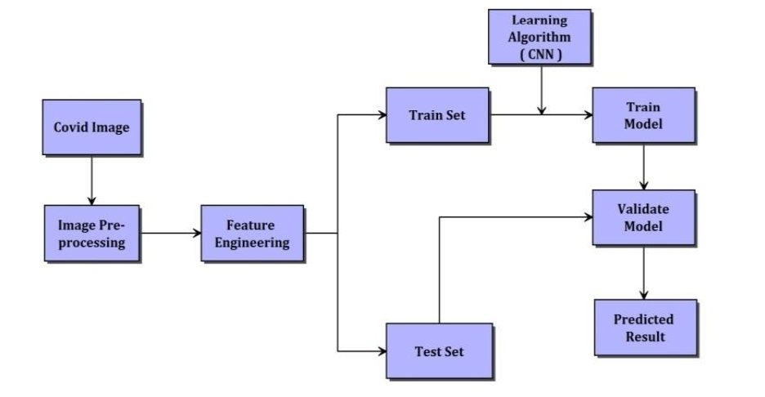
ARCHITECTURE

Slide 13
PROPOSED MODULES AND THEIR ALGORITHM DESCRIPTION
Modules:
keras
numpy
Imutils
Matplotlib
Cv2
Sklearn
Time
Argparse

Slide 14
ALGORITHMS:
VGG16:
VGG16 is a widely-used convolutional neural network architecture known for its simplicity and effectiveness. It consists of 16 weight layers, including convolutional and max-pooling layers, followed by fully connected layers. Its small 3x3 filters and uniform structure contribute to its success in various image recognition tasks, making it a popular choice for transfer learning and medical image analysis, including the detection of COVID-19 from chest X-ray images.
VGG19:
VGG19 is an extension of the VGG16 architecture, with 19 layers. It includes multiple convolutional and max-pooling layers, followed by fully connected layers for classification. VGG19 offers increased representational power compared to VGG16, making it suitable for complex tasks. However, it also requires higher computational resources. Like VGG16, it is widely used in various computer vision applications, including medical image analysis such as COVID-19 detection from chest X-ray images.
Resnet50:
ResNet50 is a deep convolutional neural network with 50 layers, known for its use of residual connections to address the vanishing gradient problem. Introduced by Microsoft Research in 2015, it has become popular for various computer vision tasks due to its strong performance. In medical image analysis, including COVID-19 detection from chest X-ray images, ResNet50's effectiveness in learning complex features makes it a preferred choice.
Saimese:
Siamese networks are a type of neural network architecture used for comparing pairs of inputs. They consist of two identical subnetworks that process each input, and their outputs are compared to measure similarity. Commonly used in tasks like image and text similarity, they can also have applications in medical image analysis for tasks such as image registration and similarity-based retrieval. However, their use in COVID-19 detection from chest X-ray images may be less common compared to other neural network architectures.

Slide 15
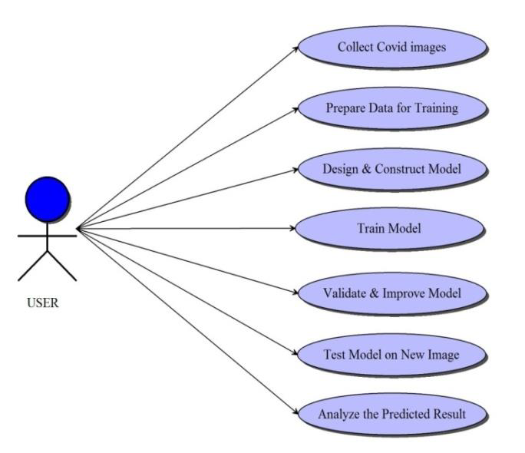
USE CASE DIAGRAM

Slide 16
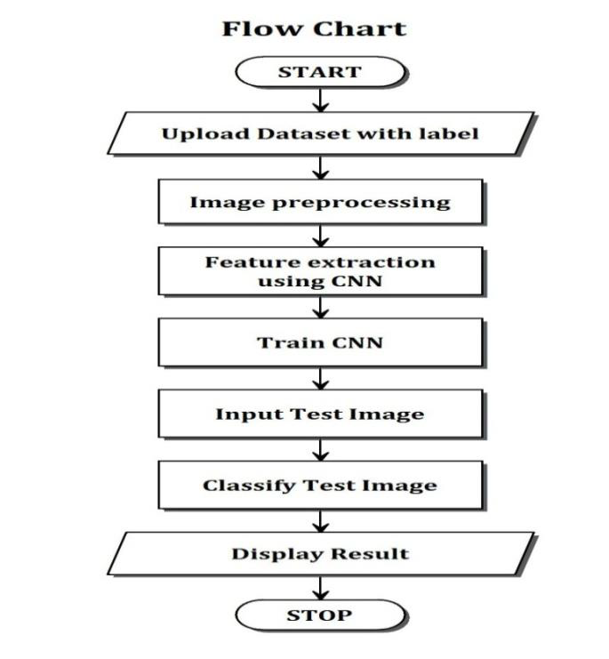
FLOW CHART

Slide 17
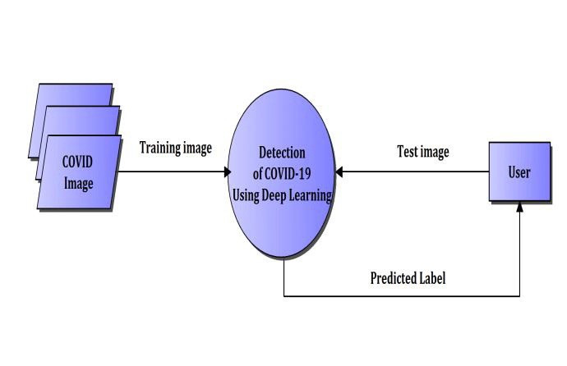
LEVEL 0 DATA FLOW DIAGRAM

Slide 18
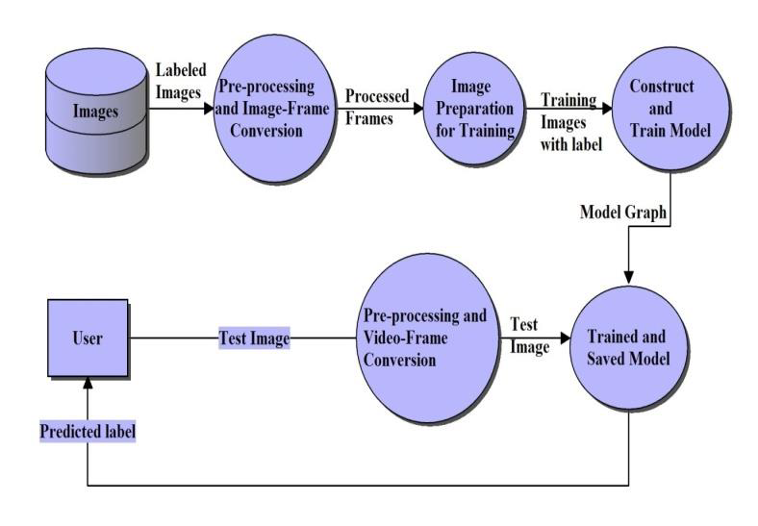
LEVEL 1 DATA FLOW DIAGRAM

Slide 19
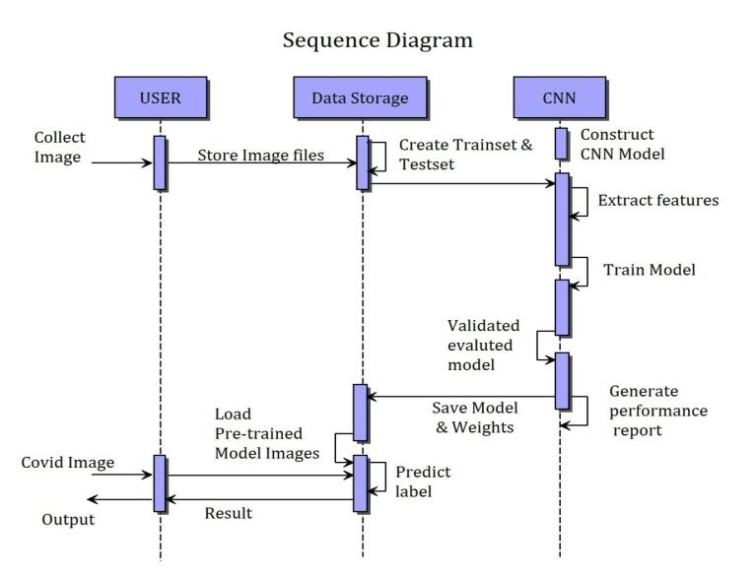
SEQUENCE DIAGRAM

Slide 20
Thank you

